Slide 1
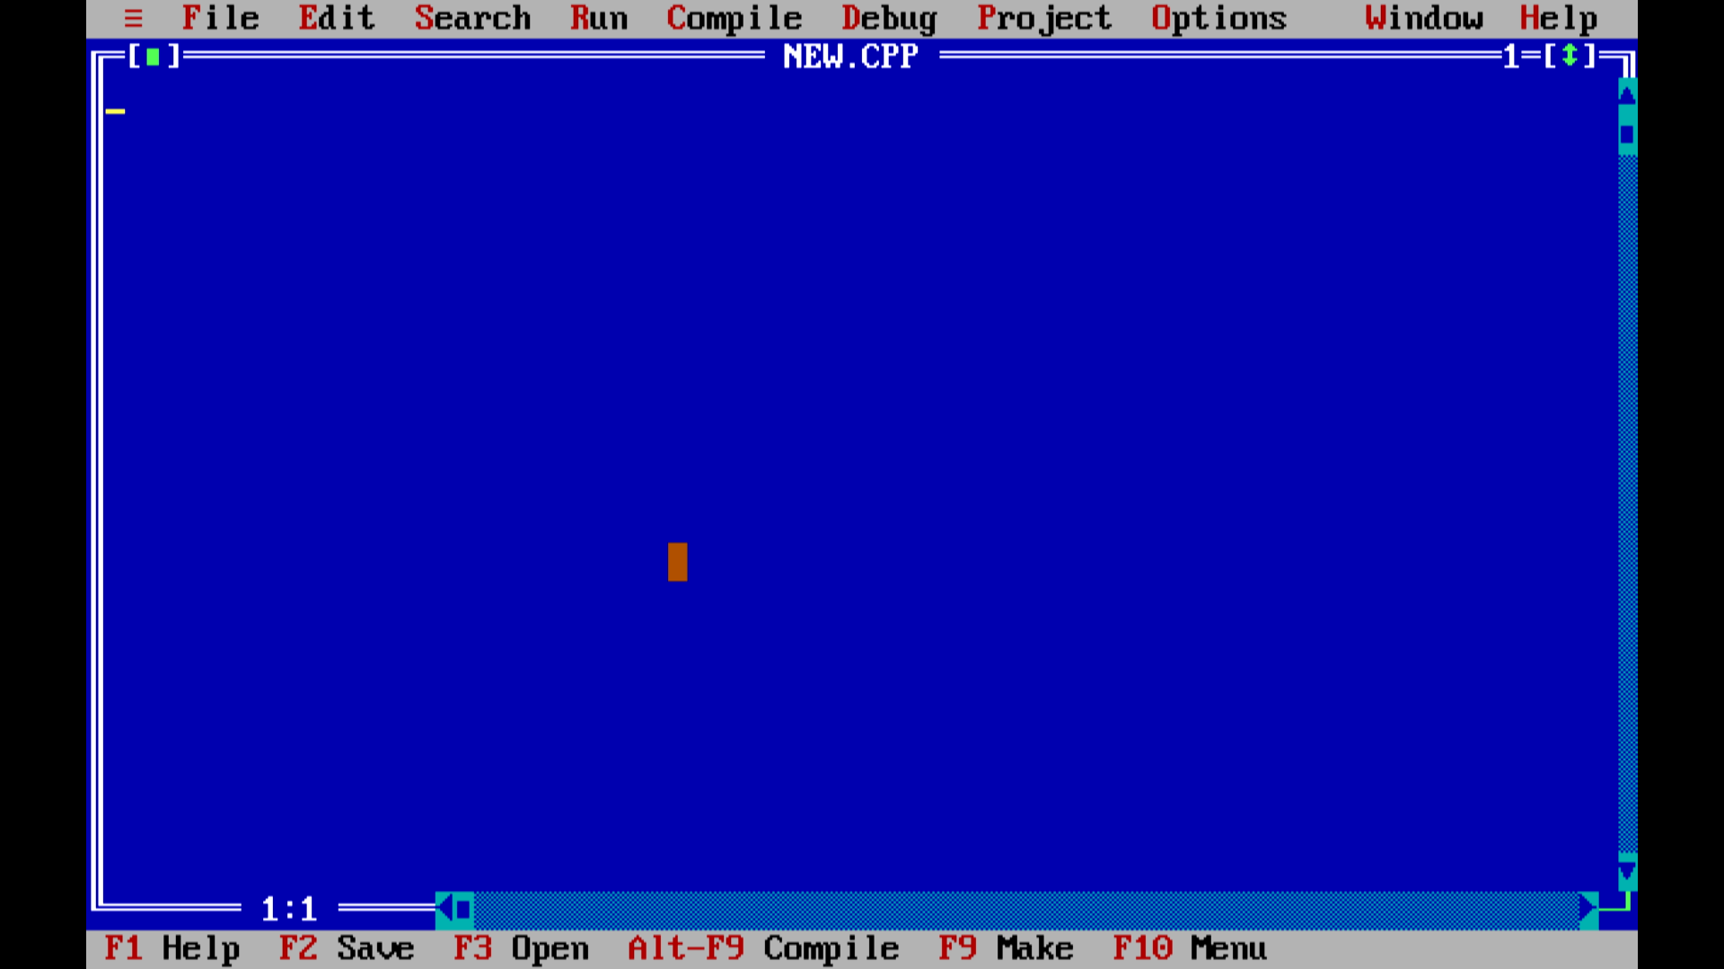
STUDENT
REPORT
CARD
S B Thejaswini
122411530229
AI-ML B

Slide 2


OVERVIEW
What is this Project?
•A C program designed to manage student report cards using Turbo C.
•Why was it created?
•To automate student grading, reduce manual errors, and store records efficiently.
•Key Features:
•- Uses structures (struct Student) to store data.
•- Calculates average and grades based on

Slide 3
ADV & DISADV
ADVANTAGES
Beginner-friendly and suitable for learning file handling in C.
•- Simple, structured, and easy to understand.
•- Data saved in text format is readable and shareable.
•- No data loss on program exit due to permanent file storage.
•- Quick access to specific student reports using roll number.
DISADVANTAGES
- Limited to 5 subjects with no subject names.
- No option to view all student records together.
- No data validation (marks range, duplicate roll numbers).
- User interface is entirely text-based.
- Designed for Turbo C, which

Slide 4


TAKEAWAYS
- Practical understanding of struct, file I/O, loops, and conditionals.
- Learned how to divide code using user-defined functions.
- Gained experience debugging in Turbo C.
- Understood the limitations of old compilers vs. modern tools.
- Built confidence in solving real-world problems with code.
Thank You!

